Slide 1
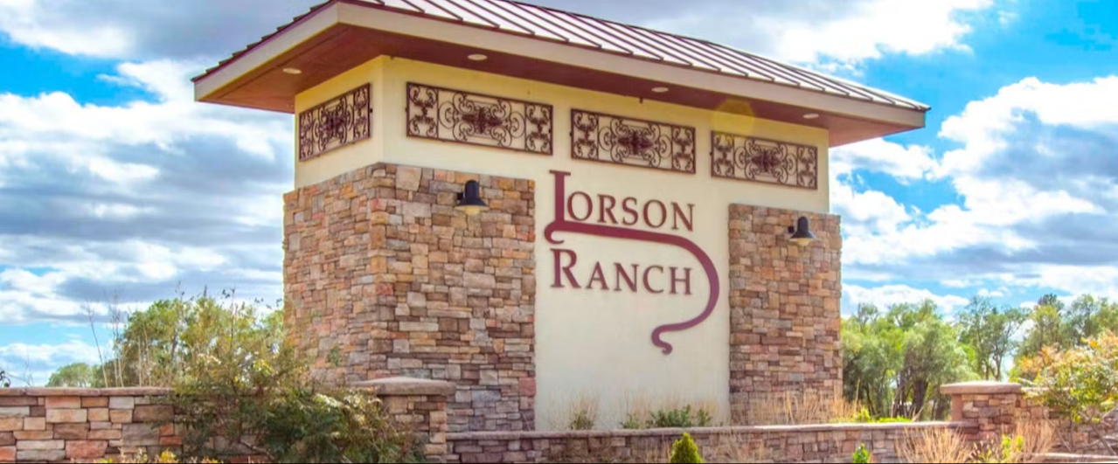
Lorson Ranch Metropolitan District No. 1-7
Annual Meeting
May 27, 2026

Slide 2

Introduction
District Management - Dominique Devaney (Public Alliance)
District Accountant – Seef Le Roux (CliftonLarsonAllen)
District Legal Counsel – Spencer Fane
https://www.lorsonranchmds.com
Lorson Ranch Metropolitan District No. 1, 5, 6 and 7 – Board of Directors
Jeff Mark - President - May 2029
Chasity McMorrow – Director - May 2027
Glenn Pawlak – Director – May 2027
Vacant – Director – May 2029
Vacant – Director – May 2027
Lorson Ranch Metropolitan District No. 2 – Board of Directors
Jeff Mark - President - May 2027
Aaron Wegener – Director - May 2029
Isreal Galvan – Director – May 2029
Andrew Wimberly – Director – May 2027
Joyce Napoleon – Director – May 2027
Lorson Ranch Metropolitan District No. 3 – Board of Directors
Kimberly Allen - May 2027
Thomas Fredericks - May 2029
Drew Bailey – May 2029
Asia Zanders - May 2027
Samuel Mitchell – May 2027
Lorson Ranch Metropolitan District No. 4 – Board of Directors
Jonathan Horwath - May 2027
David Deegan - May 2027
Adam Pastor – May 2029
James Farmer - May 2027
Frank Stephens – May 2027

Slide 3
Agenda
Outstanding Debt
Unaudited Financials
Public Infrastructure

Slide 4
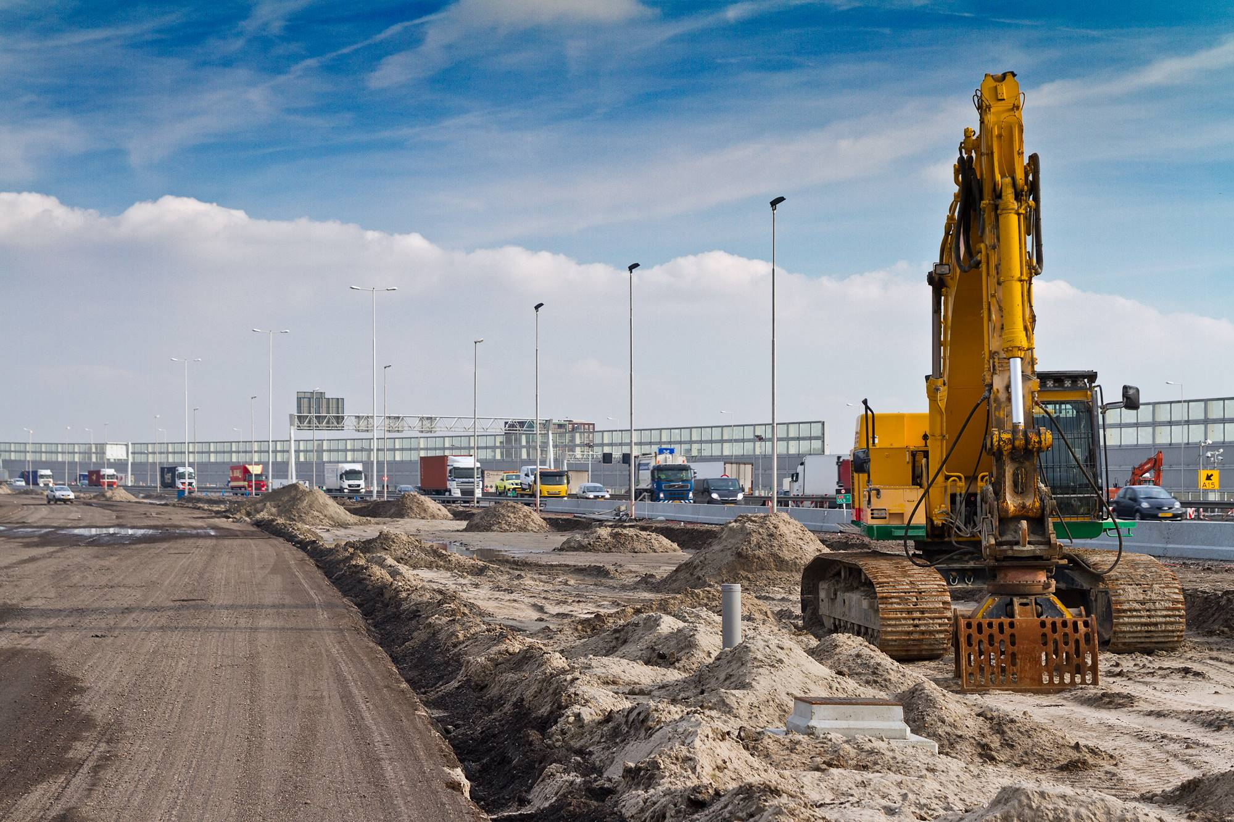
Public Infrastructure Projects

Slide 5
Development Activity
Developer Update.

Slide 6
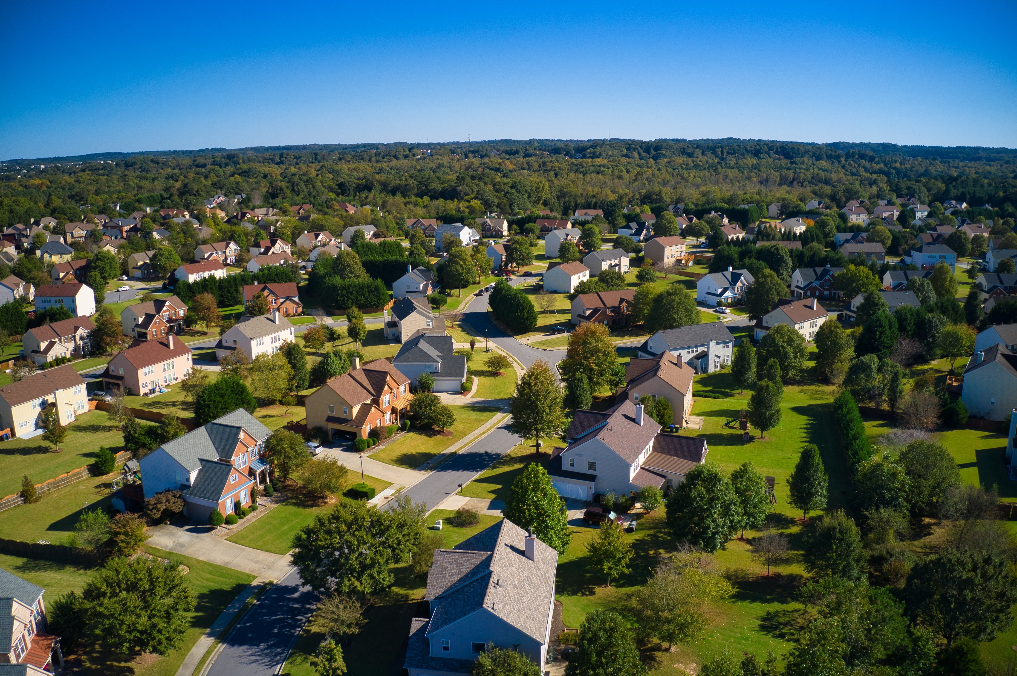
Outstanding
Debt

Slide 7
Outstanding Debt – LRMD No. 1
Series 2012 Limited Tax General Obligation Bonds
$13,929,164 Issuance
Principal Outstanding as March 31, 2026 - $9,840,166
10.00% Interest rate
Maturity: July 1, 2041
Payments: Semiannually on January 2 and July 1
Proceeds used for District public infrastructure
The principal and interest on the Bonds are payable solely from and to the extent of Pledged Revenues, which may or may not be sufficient to pay the principal and interest on the Bonds.
Loan Repayment Schedule
The Series 2012 Bonds are Cash Flow Bonds, because of the uncertainty of the timing of the principal and interest payments on the Series 2012 Bonds, no schedule of principal and interest payments is presented.
Pledged revenues collected include levied Property Tax and a portion of Specific Ownership taxes

Slide 8
Outstanding Debt – Developer Advances – LRMD No. 1
Capital Developer Advances
Advances made by Developer to pay for Public Infrastructure
$21,181 principal outstanding as of March 31, 2026
$17,089 of estimated accrued interest as of March 31, 2026
Advances bear interest at 2.00% plus the current Federal Reserve Board Prime Rate
Proceeds used for District public infrastructure
Payments: Draws on the Bonds to be used in repayment of Capital Advance and Accrued Interest
Operation Developer Advances
No Operation Developer Advances outstanding as of March 31, 2026

Slide 9
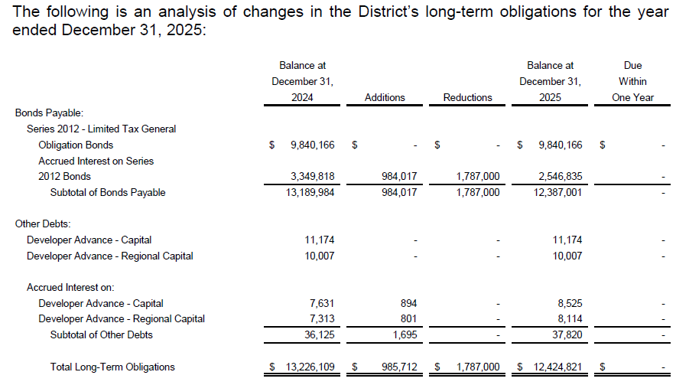
Outstanding Debt – Long-Term Liability Table – LRMD No. 1

Slide 10
Outstanding Debt – LRMD No. 2
Series 2016 Limited Tax General Obligation Bonds
$15,790,000 Issuance
Principal Outstanding as of March 31, 2026 - $15,175,000
3.00% to 5.00% Interest rate
Maturity: December 1, 2050
Payments: Semiannually on June 1 and December 1
The Bonds are subject to redemption prior to maturity without premium on or after December 1, 2027. The proceeds were used to refund the Service Districts Series 2011 and Series 2012 Limited Tax General Obligation Bonds and 2014 Reimbursement Agreement.
Required Mill Levy to fund annual payments not to exceed 50.000 mills, as adjusted
Loan Repayment Schedule
The Bonds were issued at a premium of $1,010,235. See maturity schedule on page 11.
Pledged revenues collected include levied Property Tax (up to 50.000 mills adjusted) and a portion of Specific Ownership taxes

Slide 11
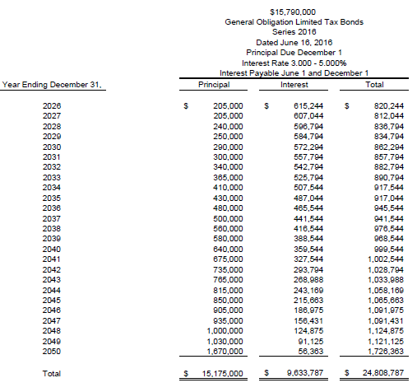
Maturity Scheule – LRMD No. 2

Slide 12
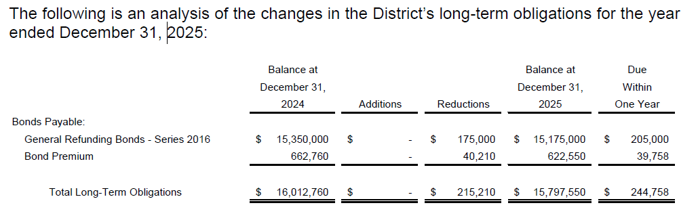
Outstanding Debt – Long-Term Liability Table – LRMD No. 2

Slide 13
Outstanding Debt – LRMD No. 3
Series 2022 Limited Tax General Obligation Draw Down Bonds
$28,471,000 Issuance – Drawdown Maximum
  $23,875,000 Drawn December 15, 2022
  $4,596,000 Drawn October 22, 2025
Principal outstanding as of March 31, 2026 - $28,471,000
6.00% Interest rate
Maturity: December 1, 2052
Payments: Semiannually on June 1 and December 1
The proceeds from the sale of the Series 2022 Bonds were used for the purposes of (i) refunding the Series 2020 Bonds; and (ii) to satisfy District No. 3’s current and anticipated future obligations of Capital Costs of public improvements that benefit the District and will and which have been funded by the Developer pursuant to the Developer Funding Agreements and prior developer capital funding agreements.
Loan Repayment Schedule
Bonds does not have a set payment schedule, rather payments are made to the extent that pledged revenues are collected.
Pledged revenues collected include levied Property Tax (up to 50.000 mills adjusted) and a portion of Specific Ownership taxes

Slide 14
Outstanding Debt – Developer Advances – LRMD No. 3
Capital Developer Advances
No Capital Developer Advances outstanding as of December 31, 2025.
Operation Developer Advances
No Operation Developer Advances outstanding as of December 31, 2025.

Slide 15
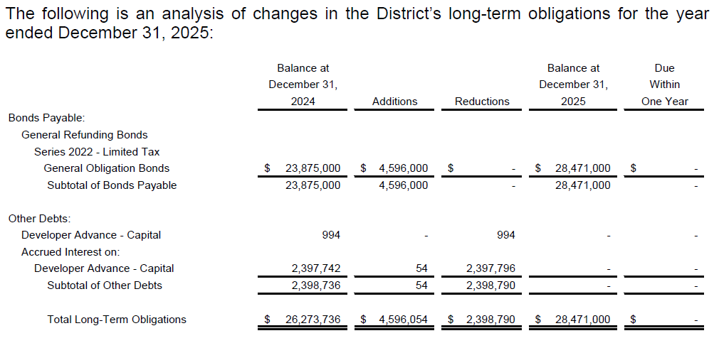
Outstanding Debt – Long-Term Liability Table – LRMD No. 3

Slide 16
Outstanding Debt – LRMD No. 4
Series 2022A Limited Tax General Obligation Draw Down Bonds
$41,260,000 Issuance – Drawdown Maximum
  $32,958,325 Drawn December 15, 2022
  $8,301,675 Drawn October 22, 2025
Principal outstanding as of March 31, 2026 - $41,260,000
5.50% Interest rate
Maturity: December 1, 2057
Payments: Semiannually on June 1 and December 1
Series 2022B Limited Tax General Obligation Subordinate Bonds
$16,400,000 Issuance
Principal outstanding as of March 31, 2026 - $14,504,000
8.00% Interest Rate
Maturity: December 15, 2027
Payments: Annually on each December 15
The Series 2022 Bonds were issued for the purposes of financing certain Public Improvements related to the Development.
Loan Repayment Schedule
Bonds does not have a set payment schedule, rather payments are made to the extent that pledged revenues are collected.
Pledged revenues collected include levied Property Tax (up to 50.000 mills adjusted) and a portion of Specific Ownership taxes

Slide 17
Outstanding Debt – Developer Advances – LRMD No. 4
Capital Developer Advances
Advances made by Developer to pay for Public Infrastructure
$3,325,576 principal outstanding as of March 31, 2026
$128,092 of estimated accrued interest as of March 31, 2026
Advances bear interest at 2.00% plus the current Federal Reserve Board Prime Rate
Proceeds used for District public infrastructure
Payments: Draws on the Bonds to be used in repayment of Capital Advance and Accrued Interest
Operation Developer Advances
No Operation Developer Advances outstanding as of March 31, 2026.

Slide 18
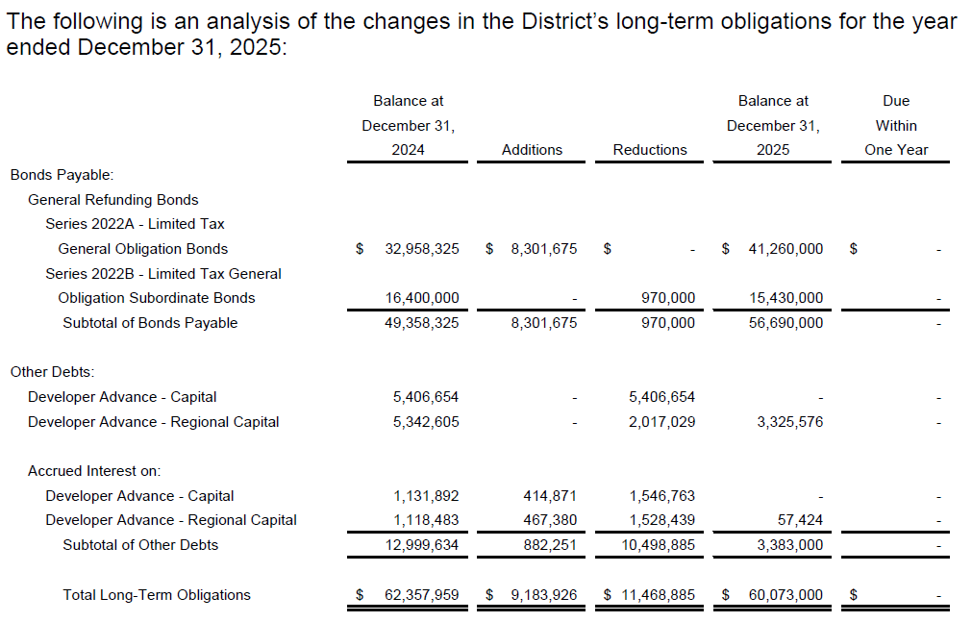
Outstanding Debt – Long-Term Liability Table – LRMD No. 4

Slide 19
Outstanding Debt – LRMD No. 6
Series 2026 Limited Tax General Obligation Bonds
$45,993,000 Issuance – May 20, 2026
5.50% Interest rate
Maturity: December 1, 2062
Payments: Annually on December 1, commencing December 1, 2026
The Series 2026 Bonds were issued for the purposes of financing certain Public Improvements related to the Development.
The Bonds shall be subject to redemption prior to maturity, at the option of the District, as a whole or in part, on any date, at a redemption price equal to the principal amount of the Bonds or portion thereof so redeemed plus accrued interest to the date of redemption, without redemption premium.
Loan Repayment Schedule
Bonds does not have a set payment schedule, rather payments are made to the extent that pledged revenues are collected.
Pledged revenues collected include levied Property Tax (up to 50.000 mills adjusted) and a portion of Specific Ownership taxes

Slide 20

Unaudited
Financial Statements

Slide 21
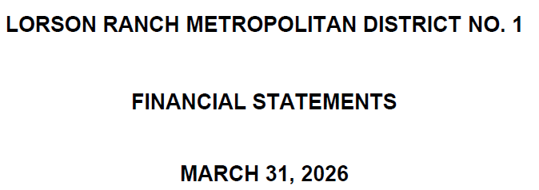

Slide 22
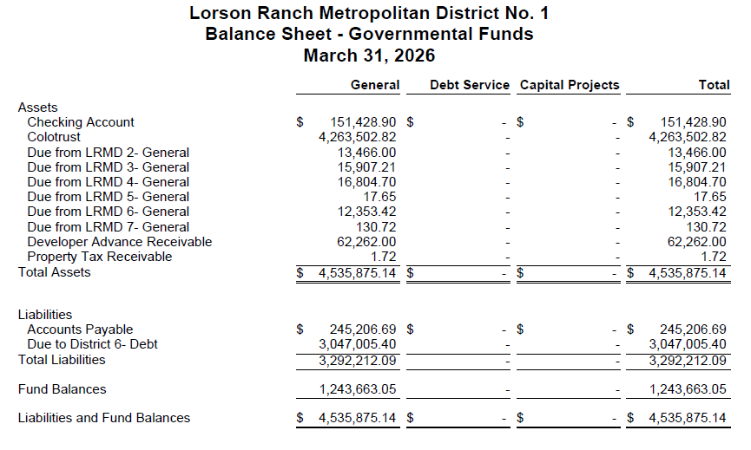

Slide 23
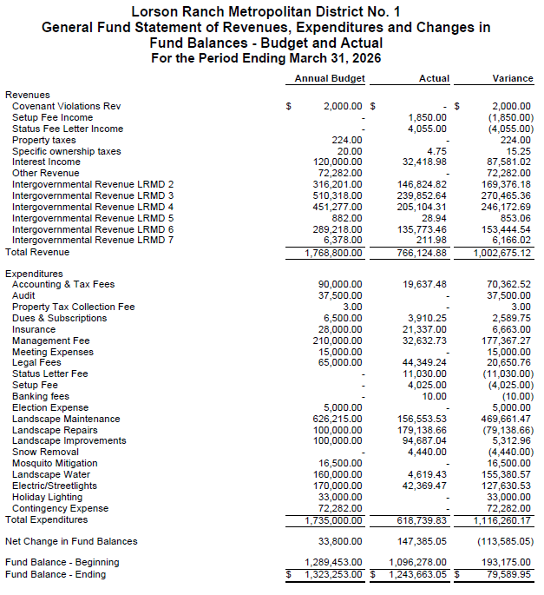

Slide 24
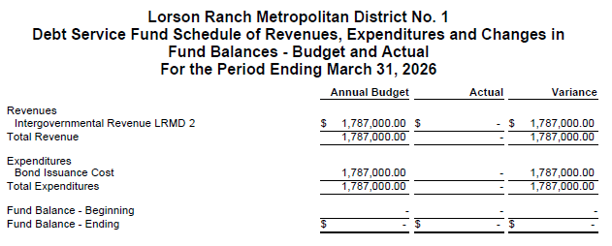

Slide 25
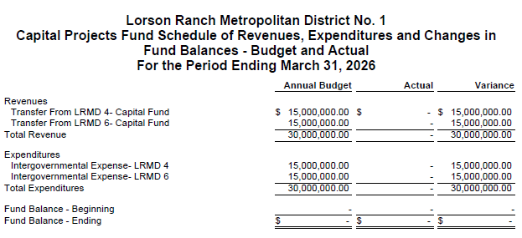

Slide 26
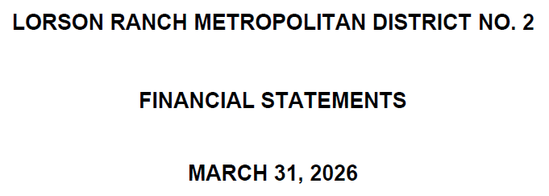

Slide 27
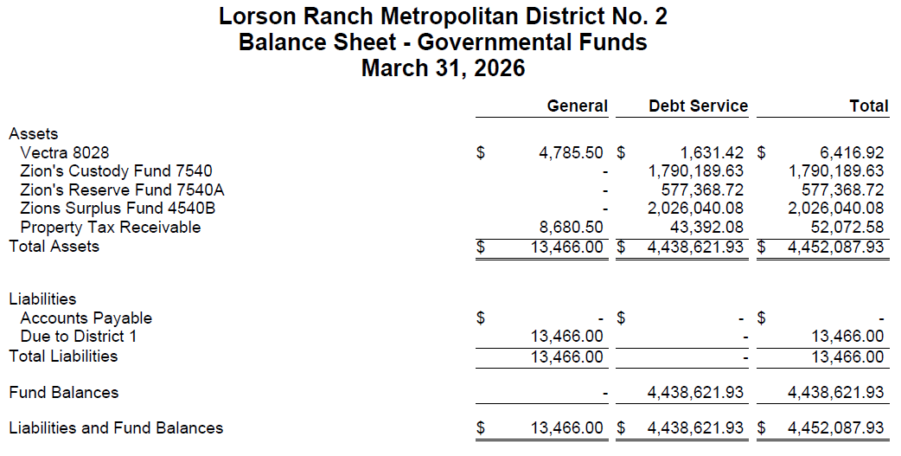

Slide 28
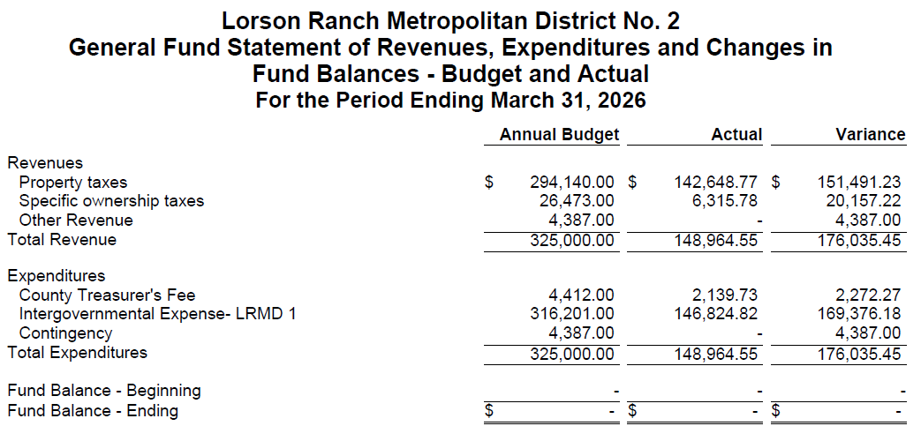

Slide 29
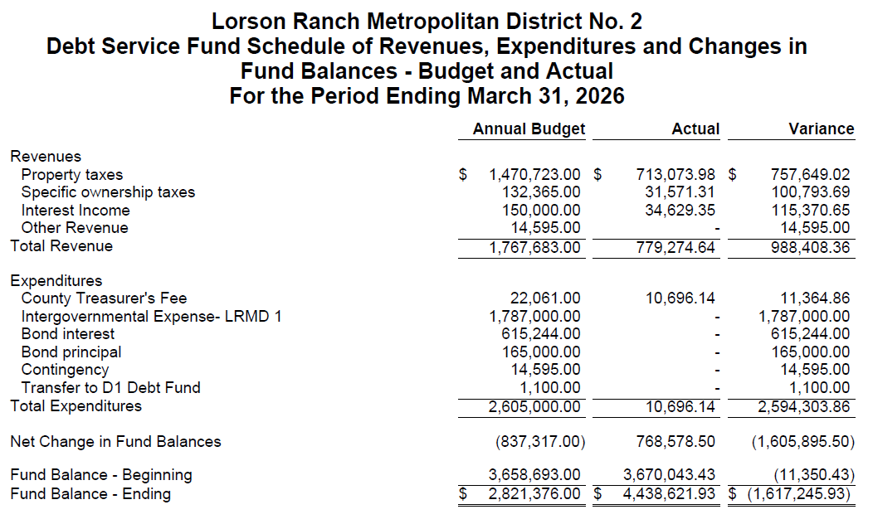

Slide 30
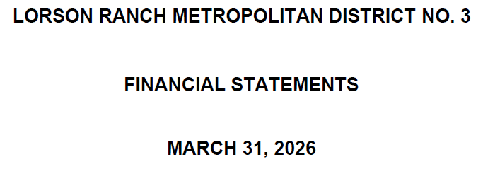

Slide 31
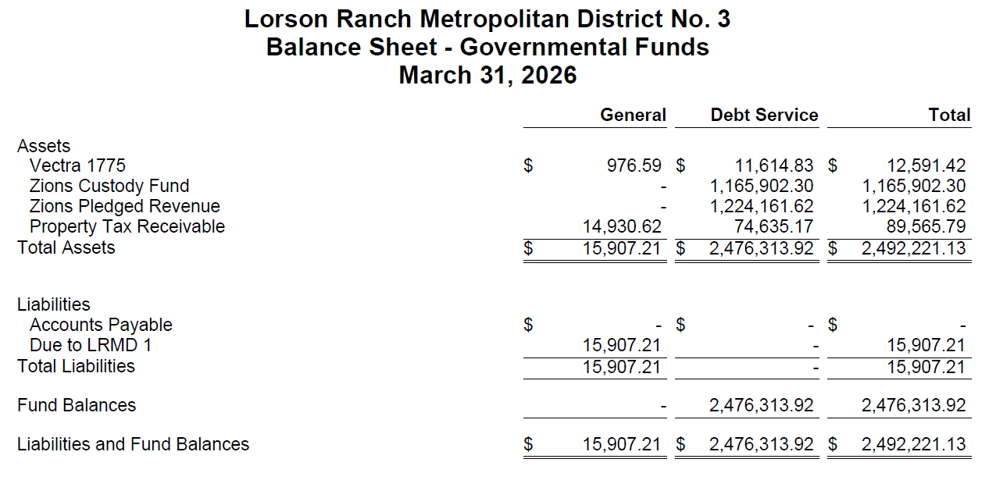

Slide 32
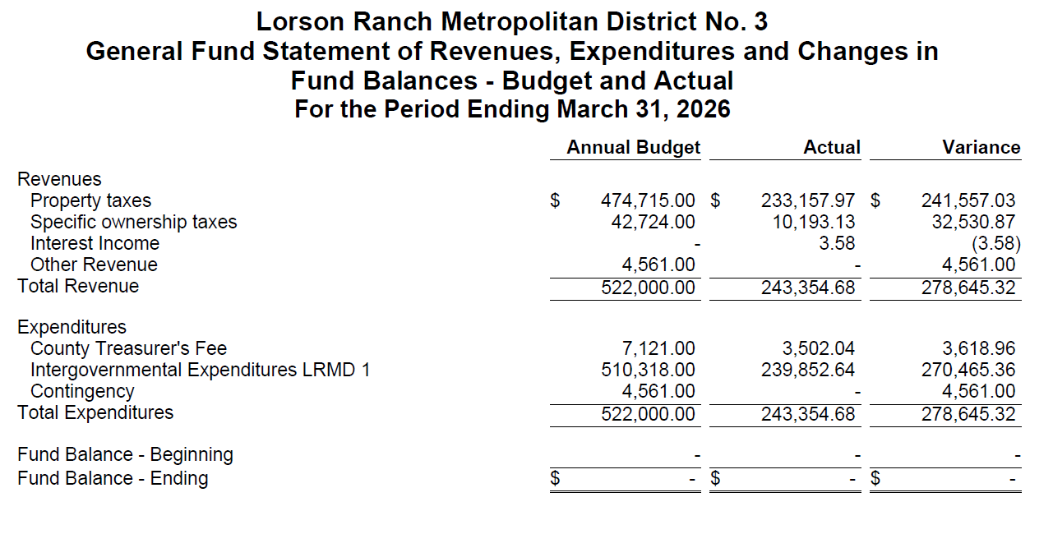

Slide 33
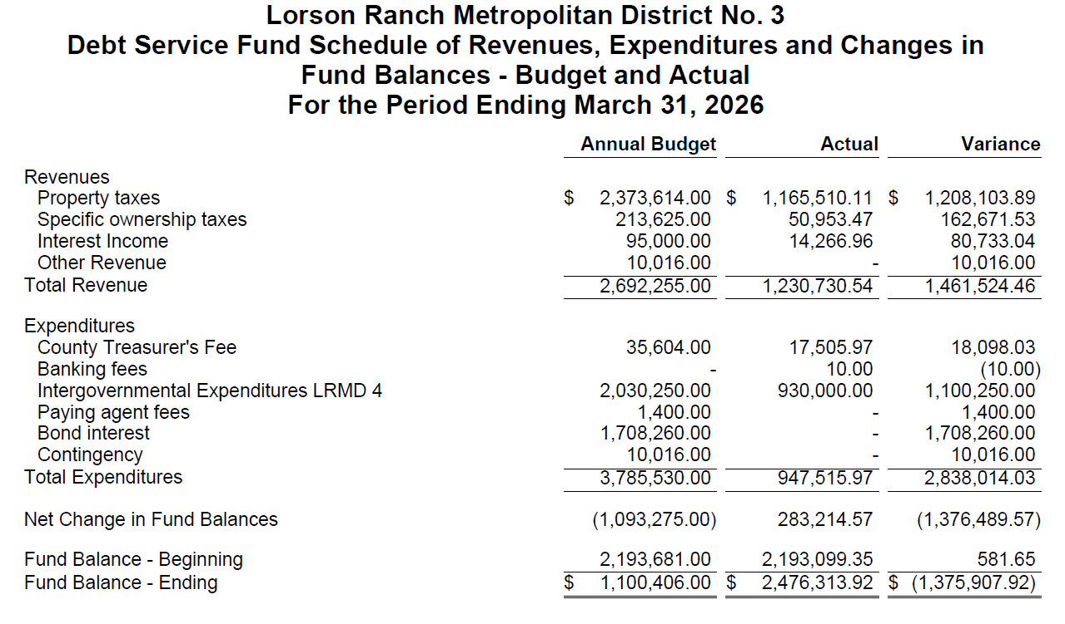

Slide 34
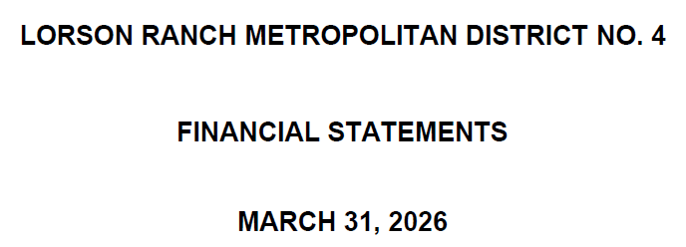

Slide 35
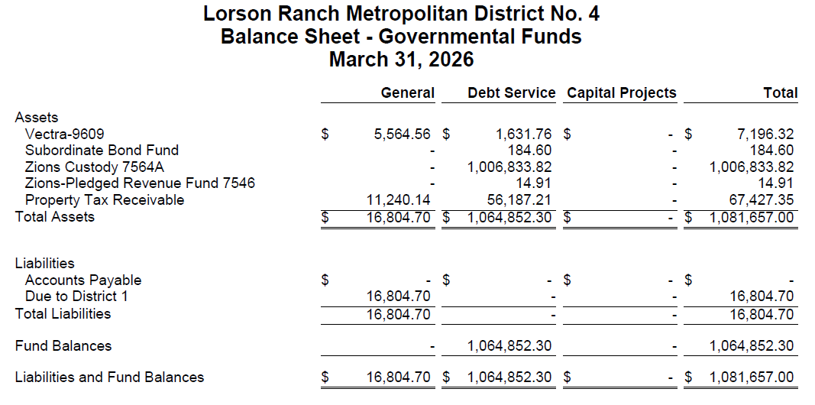

Slide 36
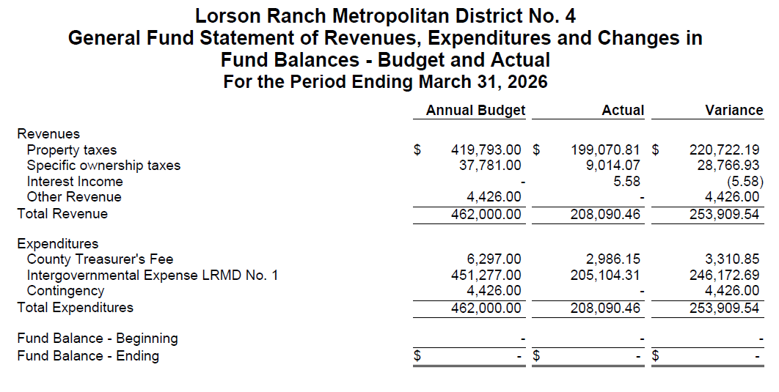

Slide 37
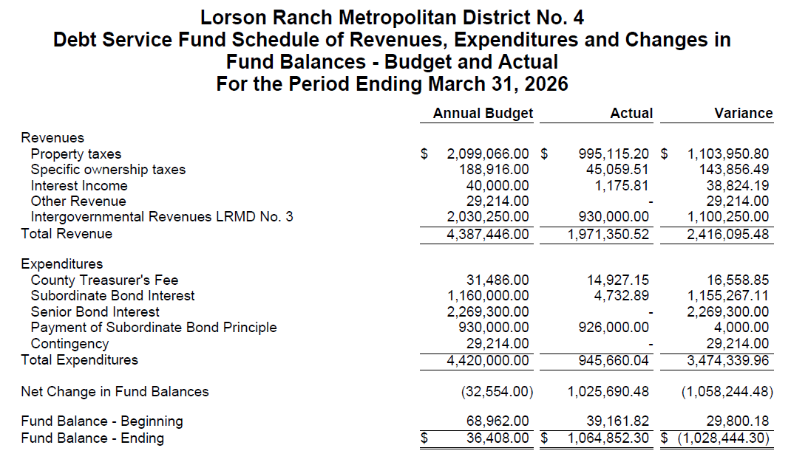

Slide 38
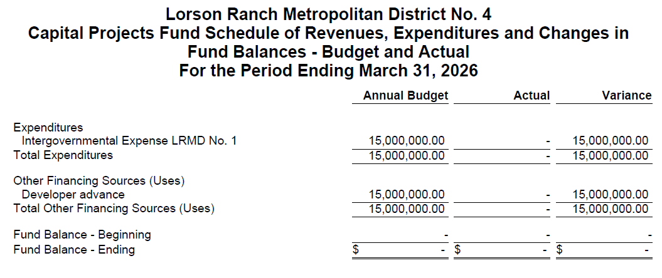

Slide 39
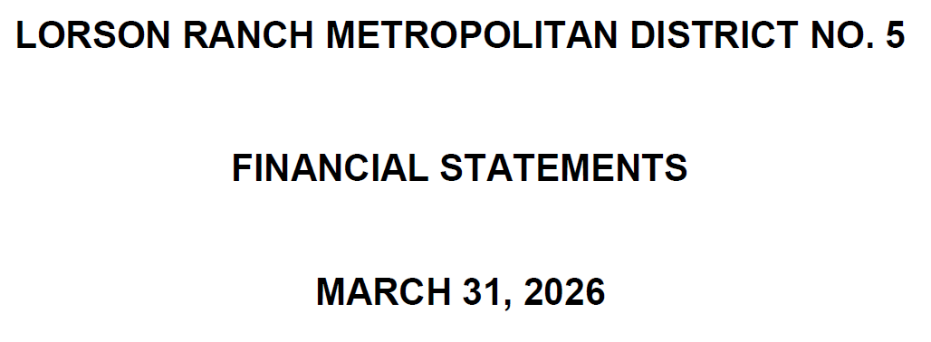

Slide 40
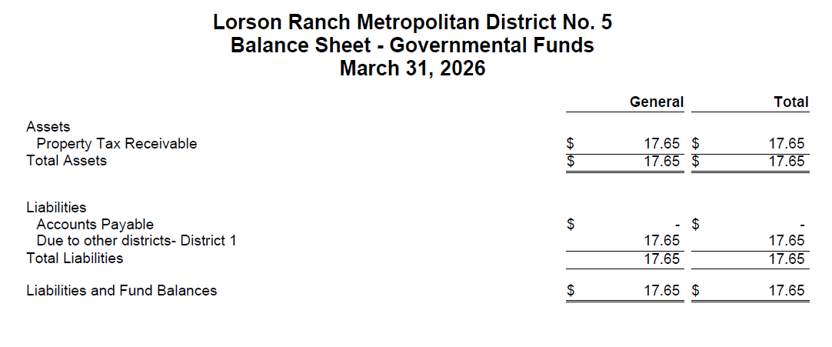

Slide 41
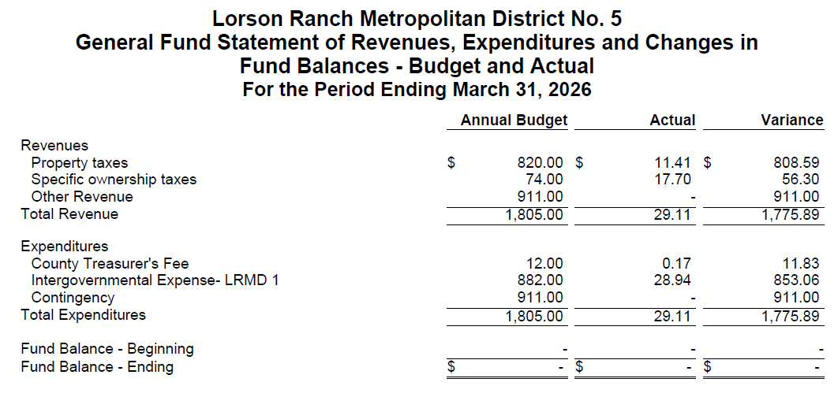

Slide 42
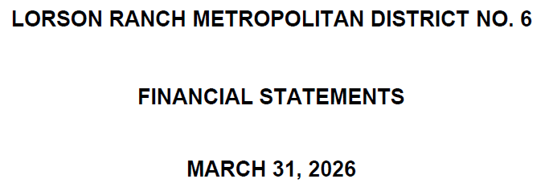

Slide 43
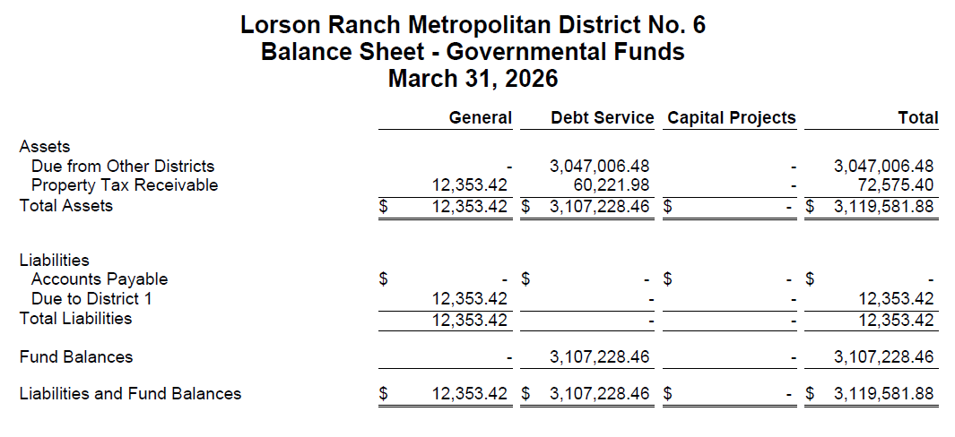

Slide 44
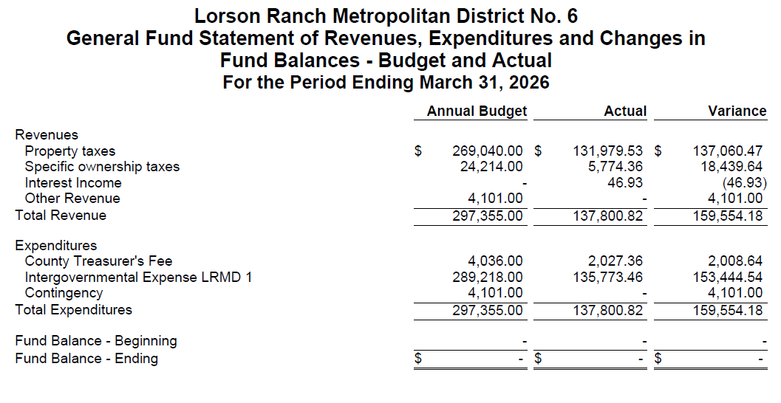

Slide 45
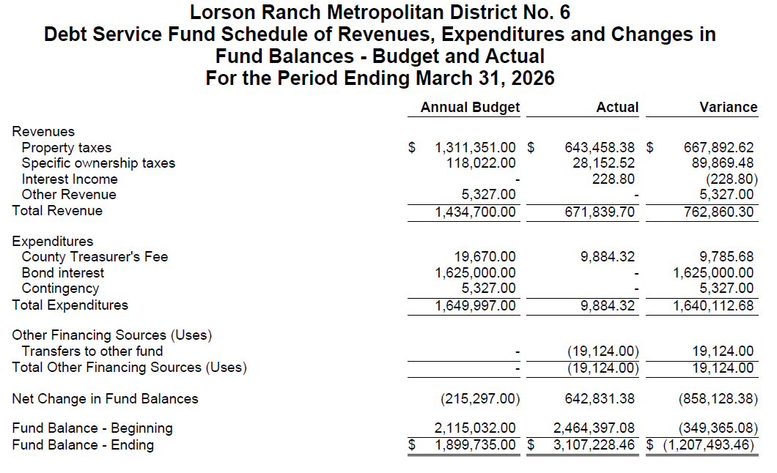

Slide 46
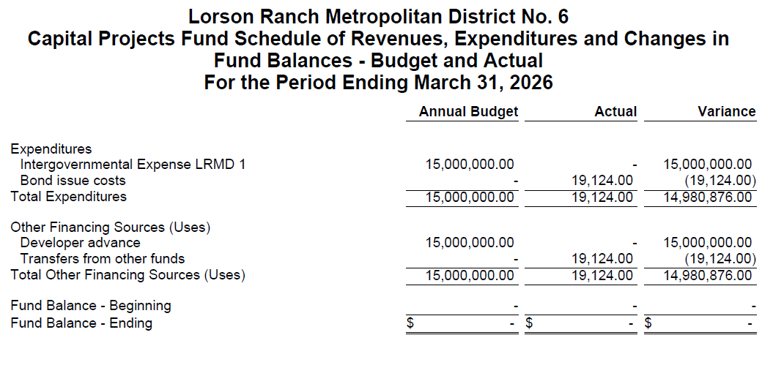

Slide 47
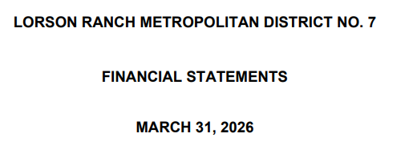

Slide 48
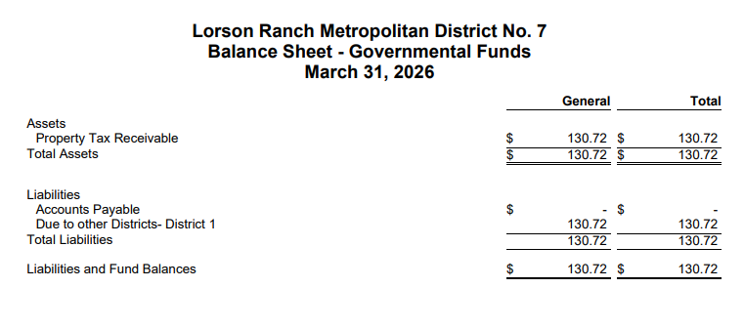

Slide 49
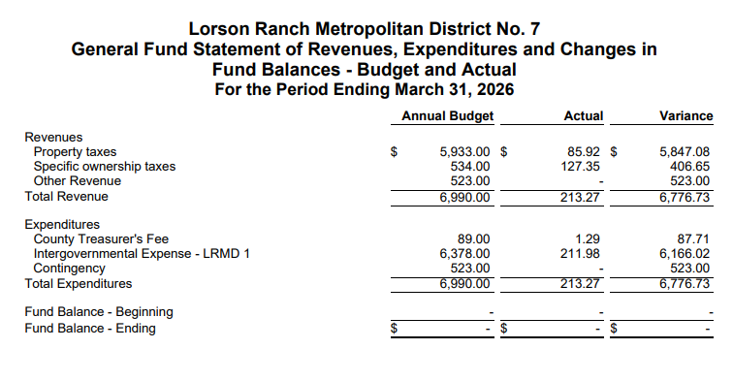

Slide 50
Questions

